Slide 1
Project MIS
6900
Sprint - I

Slide 2


1. Intro
Team
Project
Goal
- What
- When
- How Much
Team Responsibilities
Product Backlog
- User Stories
- Priority
- Size Estimate
Acceptance Criteria

Slide 3

Team
Team members:
Chetan Birthare
Yixin Zhao
Kumar Akshat

Slide 4
Project: Parts
Stock Market Data API
Use alpha-vantage combined with the power of Nodejs
3 real world algorithmic analysis
Using algorithms used by traders to analyze data
Visualize
Provide users with advice, with updated data each day by Reactjs

Slide 5
Stock Market: Data API
Alpha-vantage
Data Extracted as Dictionary
Data Cleaning
Specific Data selected, rest are removed. Result is stored as .csv file
Fast Update
Re-run of program for any ticker will just get the data not already available, saving time. Fast, efficient and quick results.

Slide 6
Stock Data:
October 1999
January 2021
November 2014
November 2020
Flexibility in date selection
Latest up to date data
 | 1999 |  |  | 2015 |  |  |  | 2021
Company Search at a click
Extensive data availability

Slide 7


Which Companies can be searched?
All of the companies listed in USA.
Tip
Foreign Companies listed in USA can also be searched through this web application.

Slide 8
3 Algorithms: Power of 3
Mean Reversion
Simple Moving
Bollinger Bands

Slide 9
2. Sprint 1
Things to be done in Sprint 1:
What: The frontend design, plus the api request setup.
When: Sprint 1 part
How Much: Front end design plus routing setup

Slide 10
Members Responsibility:
Kumar Akshat
Backend
Chetan Birthare
Backend
Yixin Zhao
Frontend

Slide 11
It’s no surprise Marcos uses Google Translate in his shop regularly.
There are 23 officially recognized languages in the EU.
Tip
Don’t let data stand alone. Always relate it back to a story you’ve already told, in this case, Marco’s shop.

Slide 12
Product Backlog:
Setting up requests and router setup: Priority - High, Size - 6 days
MVC Setup well arranged and clear: Priority - High, Size - 5 days
Website frontend representation: Priority - Medium, Size - 5 days
Correct Information representation: Priority - Low, Size - 4 days
Each run updates the graph and data files: Priority - Low, Size - 3 days
All algorithm implementation: Priority - Low, Size - 3 days
Data handling: Priority - Low, Size - 3 days
Tip
This is regarding all of the features.

Slide 13
Accepted Criteria:
Clear MVC structure
Algorithm
After first fetch, program should only update the latest data and not overwrite
Accurate output and implementation
Proper Data json output
Accurate data storage
Accurate web front-end representation

Slide 14
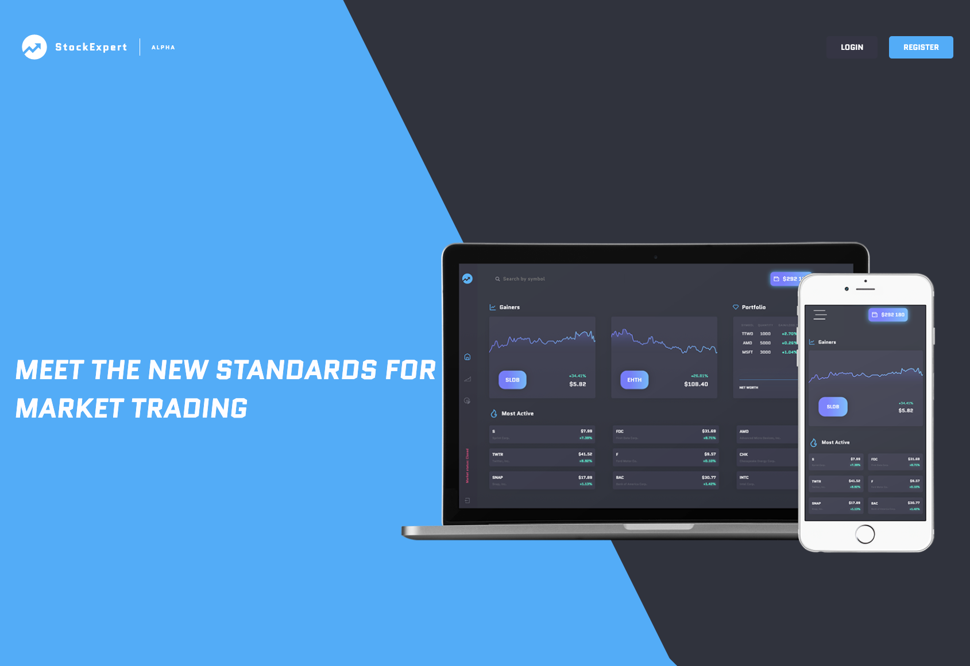
Project Demo

Slide 15


User management

Slide 16
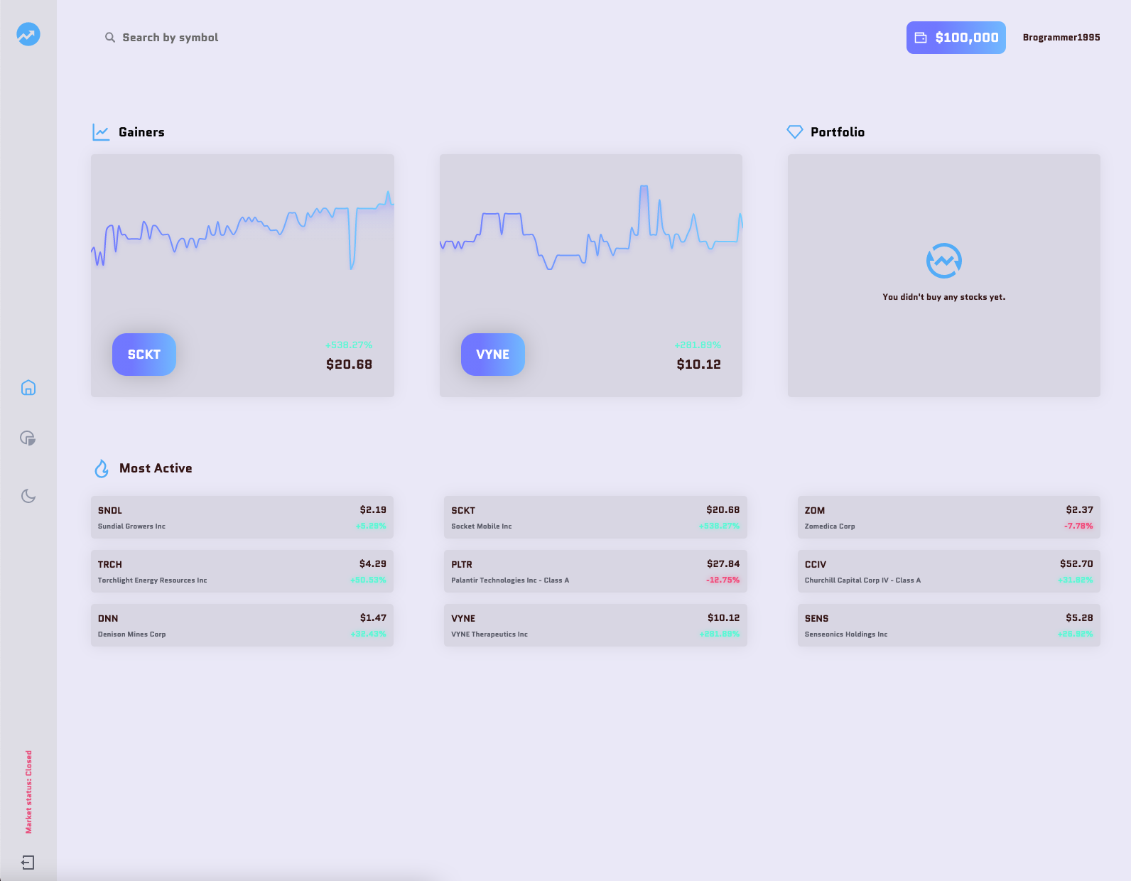
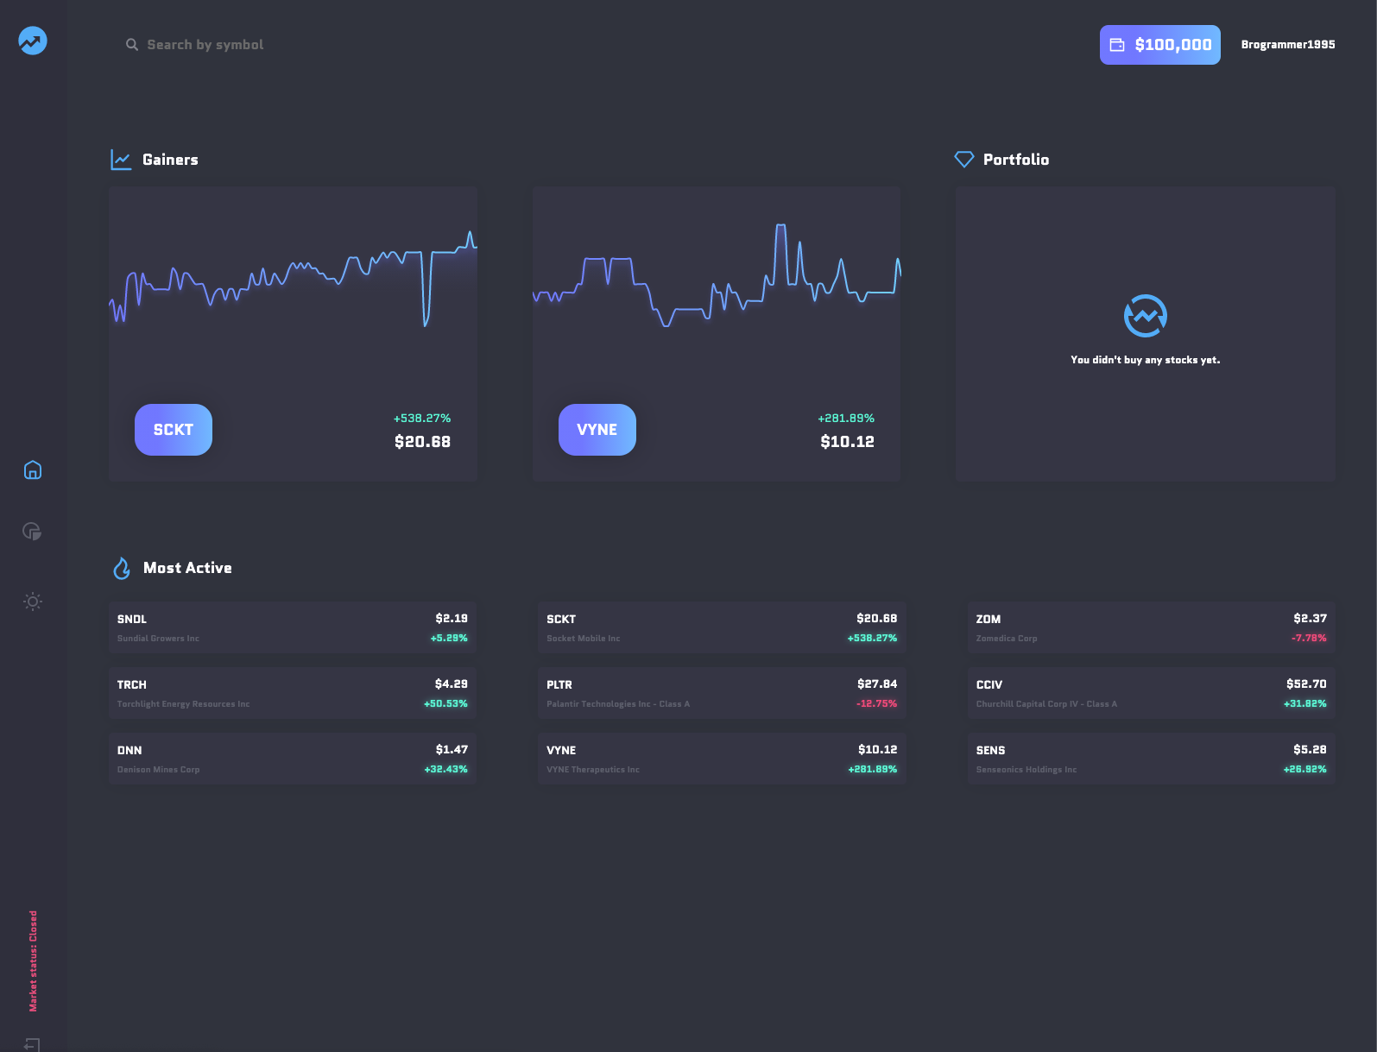
Main page

Slide 17
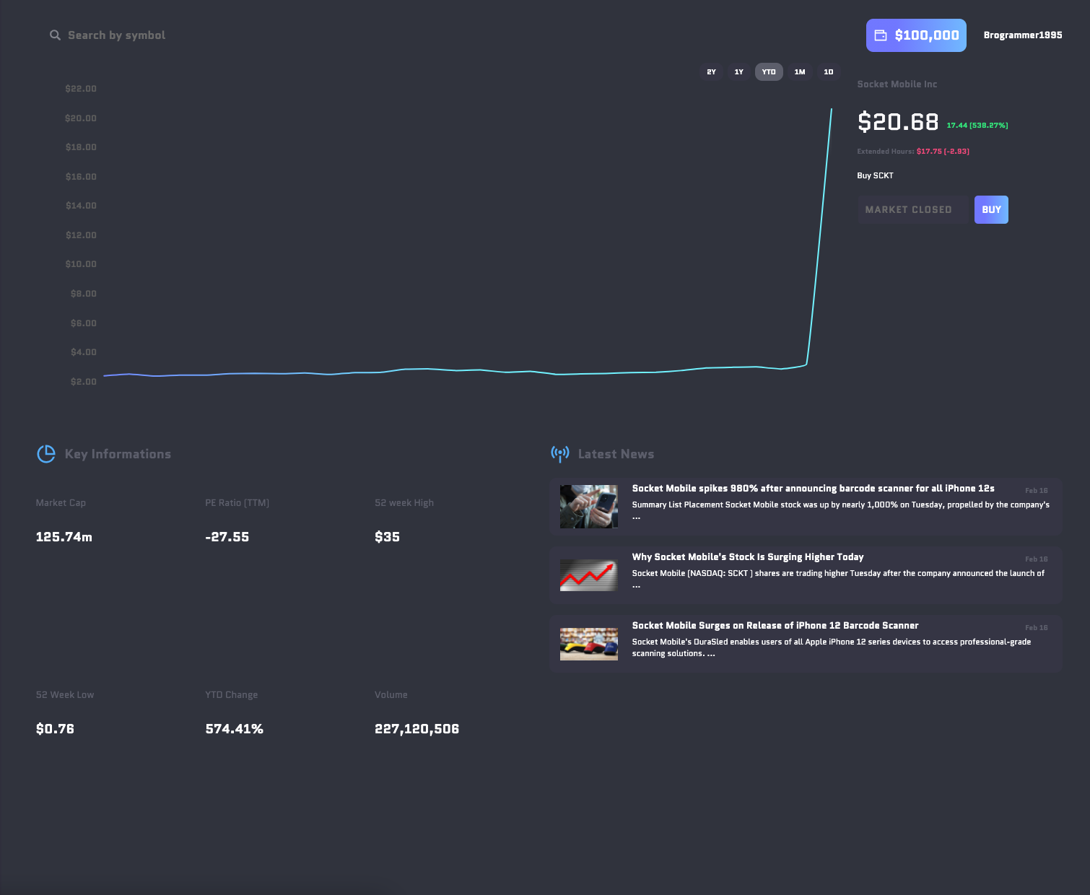
Ticker symbol

Slide 18
Good luck!
To all of us!
MIS 6900

